Slide 1
Amazon Sales Analysis

Slide 2
Introduction
Sales management is crucial in today’s competitive business landscape. It’s a key function in businesses, vital for reducing costs, increasing profits, and improving distribution methods. Its importance has grown due to the need to meet rising competition. It’s at the heart of commercial success and profitability.

Slide 3
Details of Data
The provided dataset is a comprehensive record of global sales data for a variety of products form year Feb 2010 to May 2017.
It includes details such as region, country, item type, sales channel, order priority, order date, order ID, ship date, units sold, unit price, unit cost, total revenue, total cost, and total profit.
This data can be used to analyze sales trends, profitability, and market preferences.

Slide 4
Main KPIs
Total Revenue
Total Profit
Unit sold
Trend Analysis

Slide 5
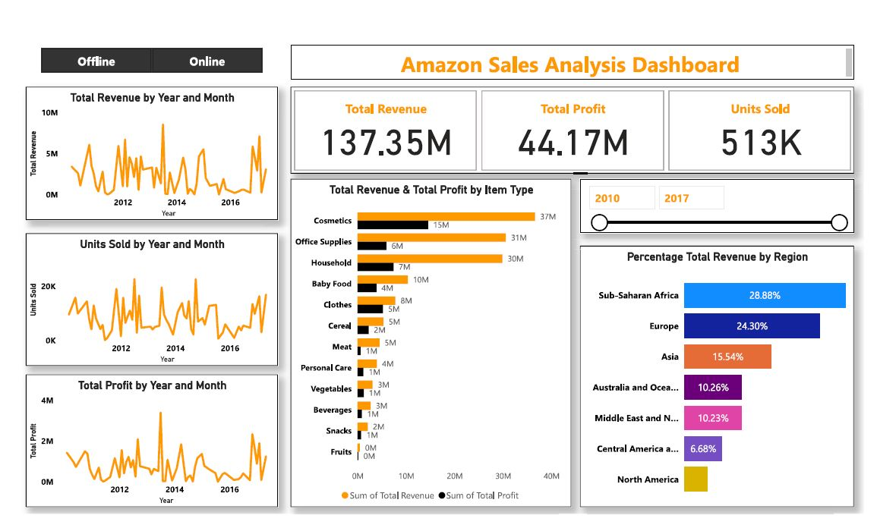
My Design

Slide 6
My Findings
Sub-Saharan Africa region contributes 28.88 % of total revenues.
Online Sales channel, Europe region contributes 26.17% percent of revenues.
Offline Sales channel, Sub-Saharan Africa contributes 32.54% of revenue.
Offline channel generate more revenue than online channel.
In offline channel, household and cosmetic are main items for revenue generators.
In online channel, cosmetics and office supplies are main items for revenue generators.
2013 is year of the highest revenue, profit and unit sold generator.

Slide 7
Thank You

